Slide 1
Constraining Electron Parallel Energy in Electrostatic Fields through the Anomalous Doppler Effect Induced by External Electromagnetic Waves
12/26/2024
Xinhang Xu

Slide 2
Brief introduction to chapter
Abstract:
What do we do in this research?
What do we find in this research?
What model do we propose to analyze the research results?
How can the findings be applied in a tokamak?
The interaction between free electrons and electromagnetic waves under the influence of magnetic and electrostatic fields is investigated using a Volume-Preserving algorithm. When the electric field of the EMW, containing a left-hand polarization component, exceeds a critical threshold, it facilitates continuous transfer of parallel electron energy into rotational energy through the Anomalous Doppler Effect (ADE). This process transforms the electric field's work along the magnetic field into perpendicular kinetic energy, leading to saturation of the electron’s parallel kinetic energy and continuous growth of its perpendicular kinetic energy. A theoretical model based on energy, momentum, and angular momentum conservation elucidates the role of left-hand polarization in the Anomalous Doppler Effect and provides a generalized framework for interpreting electron-wave interactions. This study proposes a novel approach for mitigating runaway electrons in magnetically confined plasmas, suggesting the use of extraordinary waves launched from the high-field side with an energy flux of several watts per square meter to saturate parallel energy in Tokamaks.

Slide 3
Section I. Introduction
Paragh1. How the runaway electron generate and what is the detriments of runaway electron ,what is the possible way to suppress RE.
Paragh2. The three ways to suppress RE and the strengths and weaknesses of each method. The ADE provides a cleaner mechanism, making it a particularly attractive avenue for further investigation.
Paragh3-4. What is ADE and what phenomenon is related to ADE ?
Paragh5. Comment on the experiment to suppress RE by ADE in a tokamak.
Paragh6. History research on ADE: what remains unclear about ADE?
Paragh7. Research method in this paper and summary the main results.
Paragh8. introduce each section in the paper.
Section II .Quantum theory of ADE
Section III . The numerical simulation framework and results.
Section IV . The trapping threshold.
Section V . Explores the dynamics of electromagnetic waves driving the Anomalous Doppler Effect in magnetized plasma.
Section VI . Introduce the runaway electron suppression method using extraordinary wave injection.
Section VII . Summary.

Slide 4
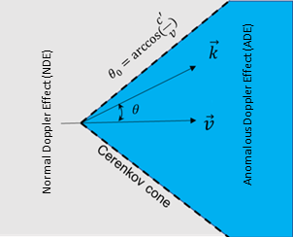
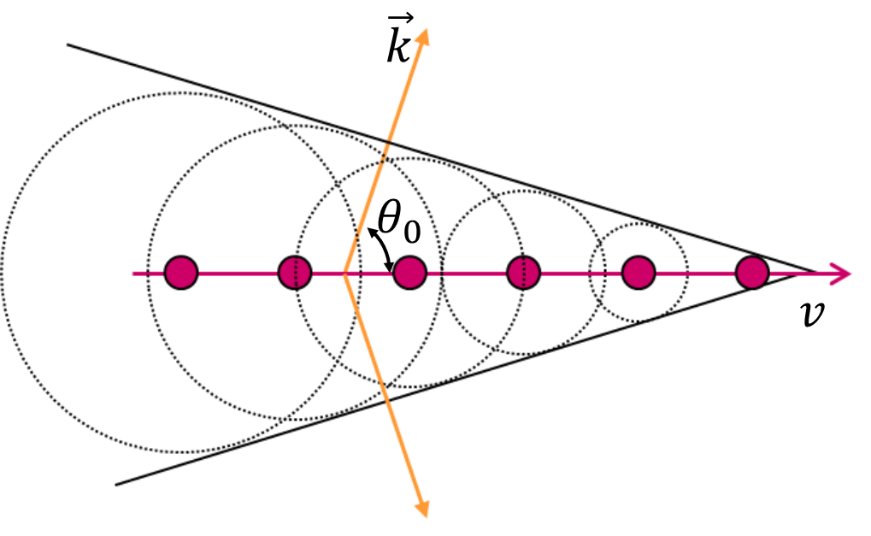

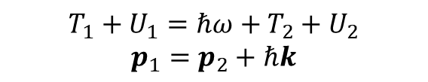
Section II .Quantum theory of ADE
$$T=γm_{0}c^{2}−m_{0}c^{2}$$
$γm_{0}c^{2}=$ $\sqrt{p^{2}c^{2}+m_{0}^{2}c^{4}}$
$$\frac{dT}{dp}=\frac{p}{γm_{0}}=v$$
$$dT=\frac{dT}{dp}⋅dp=v⋅dp$$
The electron without circular rotation(internal energy) can only emit photon in Cerenkov direction when its speed surpass light in medium
The electron with circular rotation(internal energy) can emit photon in arbitrary direction
$$T_{1}+U_{1}=ℏω+T_{2}+U_{2}$$
$$p_{1}=p_{2}+ℏk$$

Slide 5
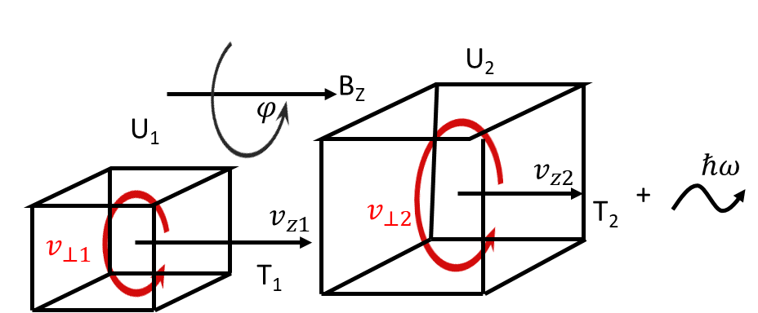
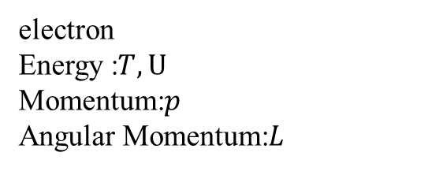

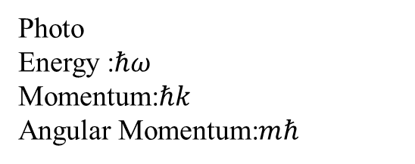

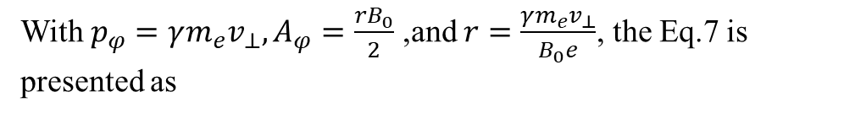
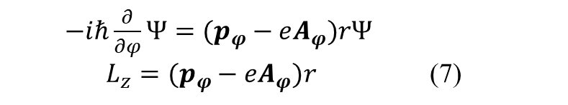
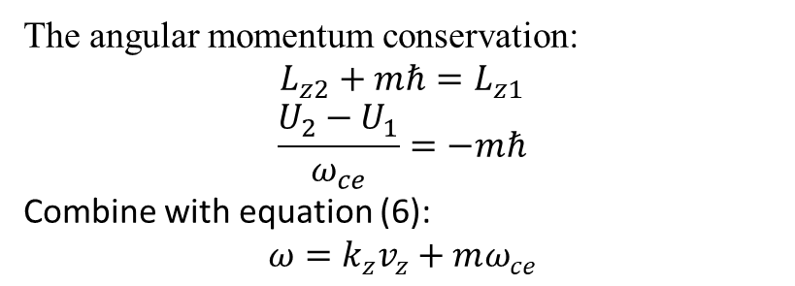
The electron wave in the static magnetic field can be presented
$$Ψ=Ψ_{0}e^{\frac{i}{ℏ}(p−eA)⋅s}$$
The intrinsic equation of angular momentum in the z-direction has been transformed as
$−iℏ\frac{∂}{∂φ}Ψ=(p_{φ}−eA_{φ})rΨ$
$L_{z}=(p_{φ}−eA_{φ})r$ (7)
With $p_{φ}=γm_{e}v_{⊥},A_{φ}=\frac{rB_{0}}{2}$ ,and $r=\frac{γm_{e}v_{⊥}}{B_{0}e}$, the Eq.7 is presented as
Photo
Energy :$ℏω$
Momentum:$ℏk$
Angular Momentum:$mℏ$
electron
Energy :$T,U$
Momentum:$p$
Angular Momentum:$L$
$L_{z}=\frac{1}{2}\frac{γm_{e}v_{⊥}^{2}}{ω_{ce}}=\frac{U}{ω_{ce}} , ω_{ce}=\frac{eB}{m_{e}γ}=\frac{ω_{0}}{γ}$ (8)
The angular momentum conservation:
$$L_{z2}+mℏ=L_{z1}$$
$$\frac{U_{2}−U_{1}}{ω_{ce}}=−mℏ$$
Combine with equation (6):
$$ω=k_{z}v_{z}+mω_{ce}$$
（6）

Slide 6
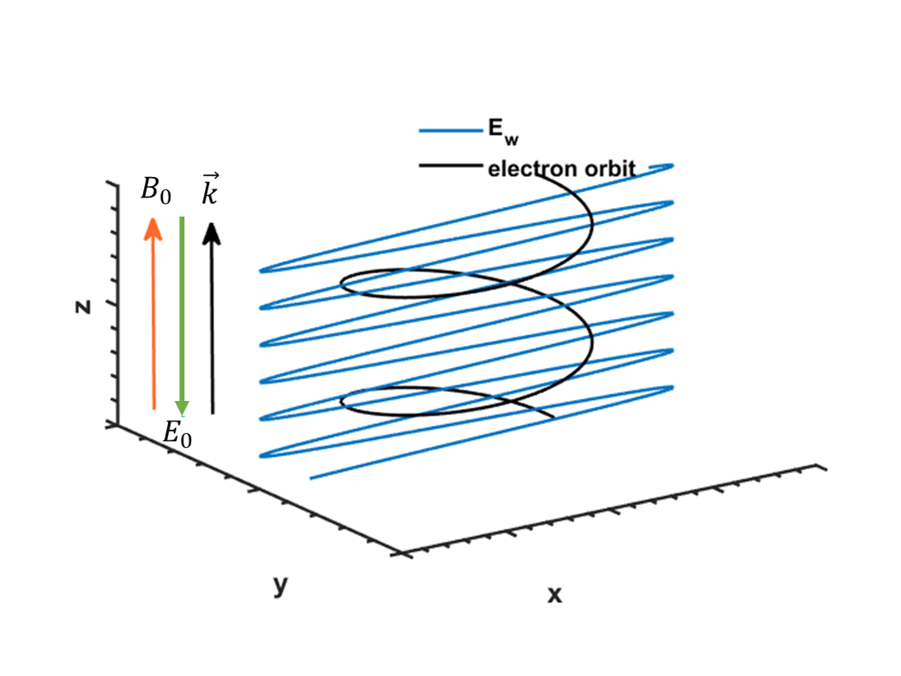
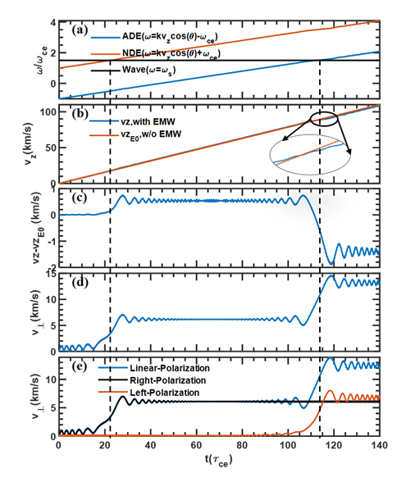
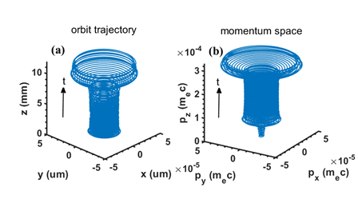
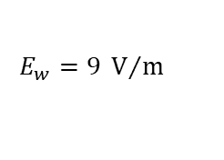




Section III. Numerical Simulation Framework and Result Discussion
$B_{0}$ = $0.02T$
$$ω_{s}=1.5 ω_{0}$$
$\vec{k}$ $=10^{5}/m$
$$E_{w}=9 V/m$$
$$E_{0}=−2.5 V$$

Slide 7
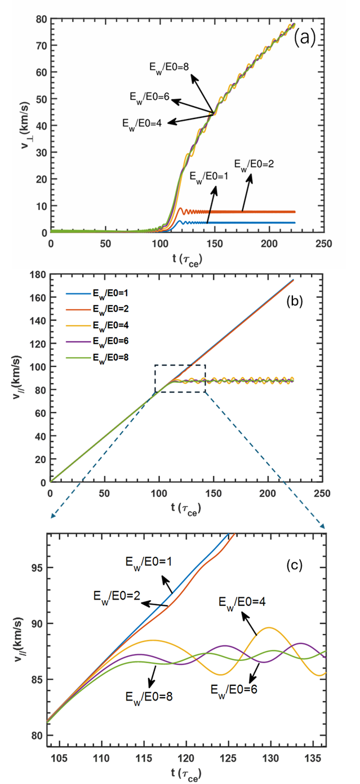
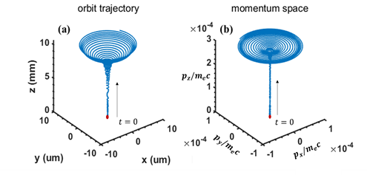
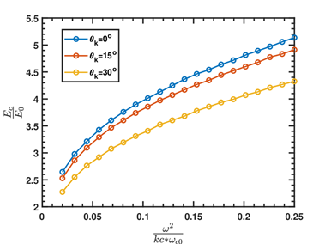
Section IV. Critical Trapping Threshold
Velocity changes under different EMW energy

Slide 8
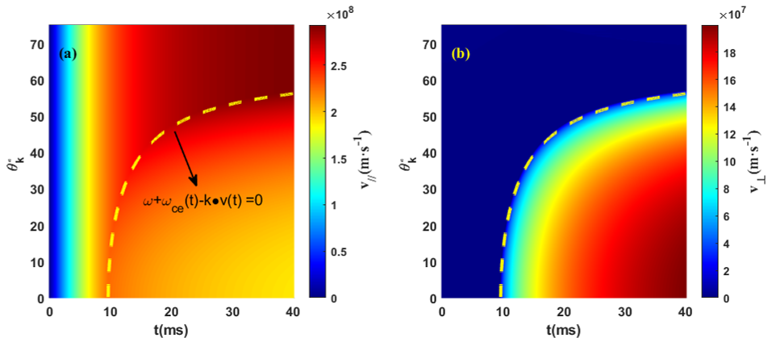
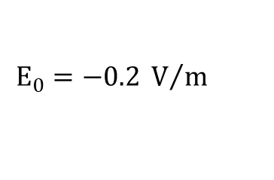


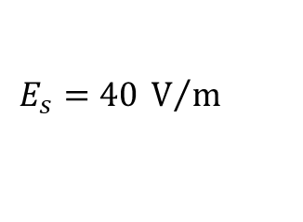

Simulation under typical tokamak startup conditions
$B=2 T$
$$E_{0}=−0.2 V/m$$
$$f=56 GHz$$
$$E_{s}=40 V/m$$
P$≈$9W/m^2
Data provided by 李文祥（刘健老师组）
Parallel velocity constricted after resonance
Vertical velocity increase after resonance

Slide 9
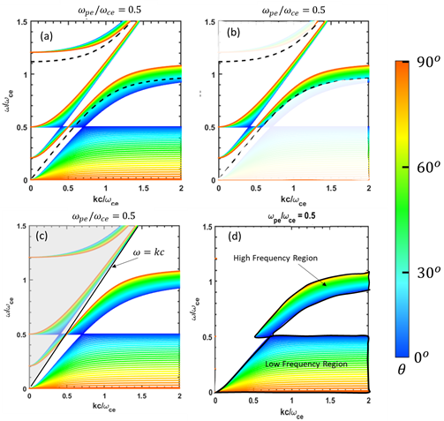
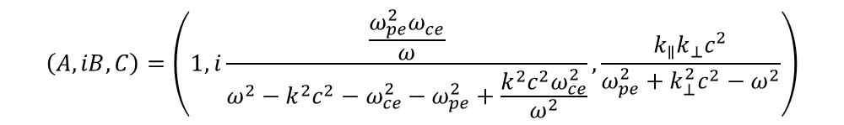
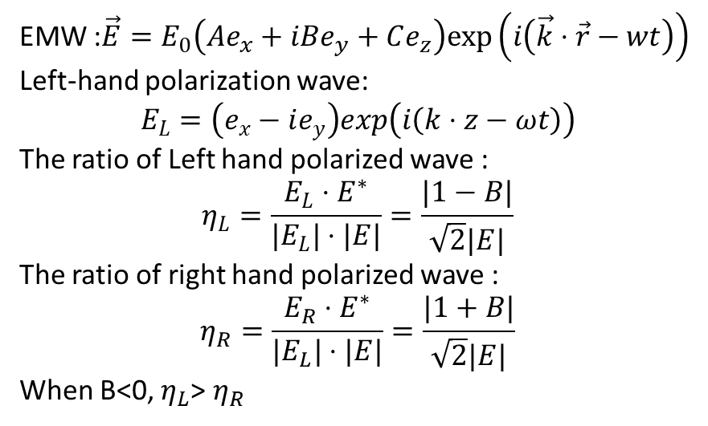
Section V. Electromagnetic wave drives the Anomalous Doppler Effect in magnetized plasma
ADE requirement for wave:
1.Left hand polarized wave
2.Surpass the light velocity in plasma
Polarization analysis:
$$\left(A,iB,C\right)=\left(1,i\frac{\frac{ω_{pe}^{2}ω_{ce}}{ω}}{ω^{2}−k^{2}c^{2}−ω_{ce}^{2}−ω_{pe}^{2}+\frac{k^{2}c^{2}ω_{ce}^{2}}{ω^{2}}},\frac{k_{∥}k_{⊥}c^{2}}{ω_{pe}^{2}+k_{⊥}^{2}c^{2}−ω^{2}}\right)$$
EMW :$\vec{E}=E_{0}\left(Ae_{x}+iBe_{y}+Ce_{z}\right)exp\left(i\left(\vec{k}⋅\vec{r}−wt\right)\right)$
Left-hand polarization wave:
$$E_{L}=\left(e_{x}−ie_{y}\right)exp\left(i\left(k⋅z−ωt\right)\right)$$
The ratio of Left hand polarized wave :
$$η_{L}=\frac{E_{L}⋅E^{∗}}{|E_{L}|⋅|E|}=\frac{|1−B|}{\sqrt{2}|E|}$$
The ratio of right hand polarized wave :
$$η_{R}=\frac{E_{R}⋅E^{∗}}{|E_{L}|⋅|E|}=\frac{|1+B|}{\sqrt{2}|E|}$$
When B<0, $η_{L}$> $η_{R}$

Slide 10
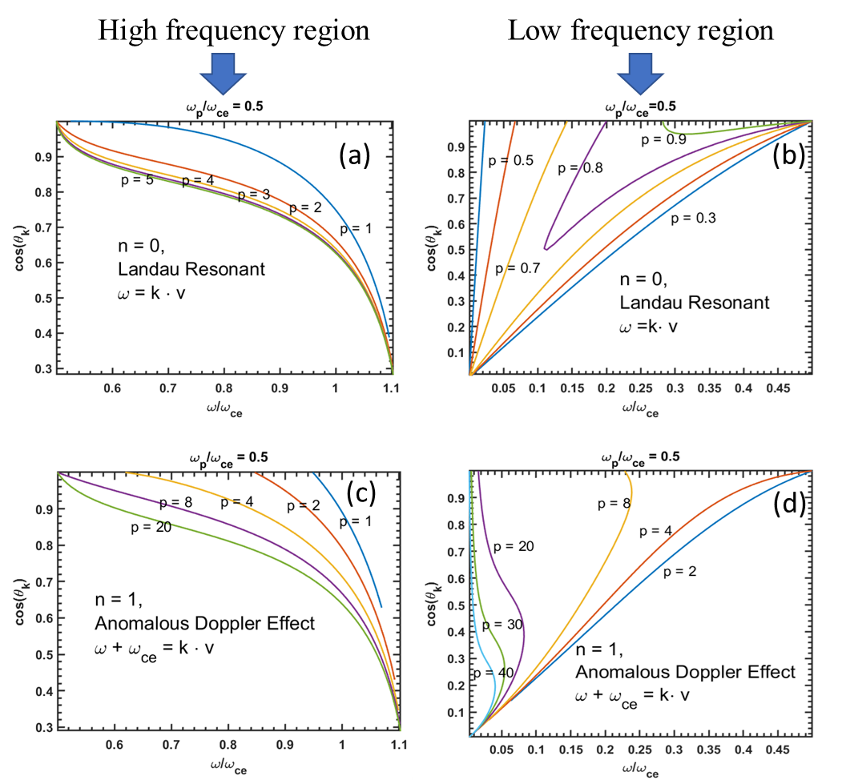
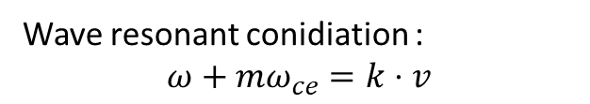
Wave resonant conidiation :
$$ω+mω_{ce}=k⋅v$$
High frequency region have less attenuation by background thermal electrons compare to low frequency region
whistler waves is typically linked to the detection of high-energy electrons with energies exceeding 10 MeV*
*First direct observation of runaway-electron-driven whistler waves in tokamaks. Physical Review Letters, 120(15):155002, 2018.

Slide 11
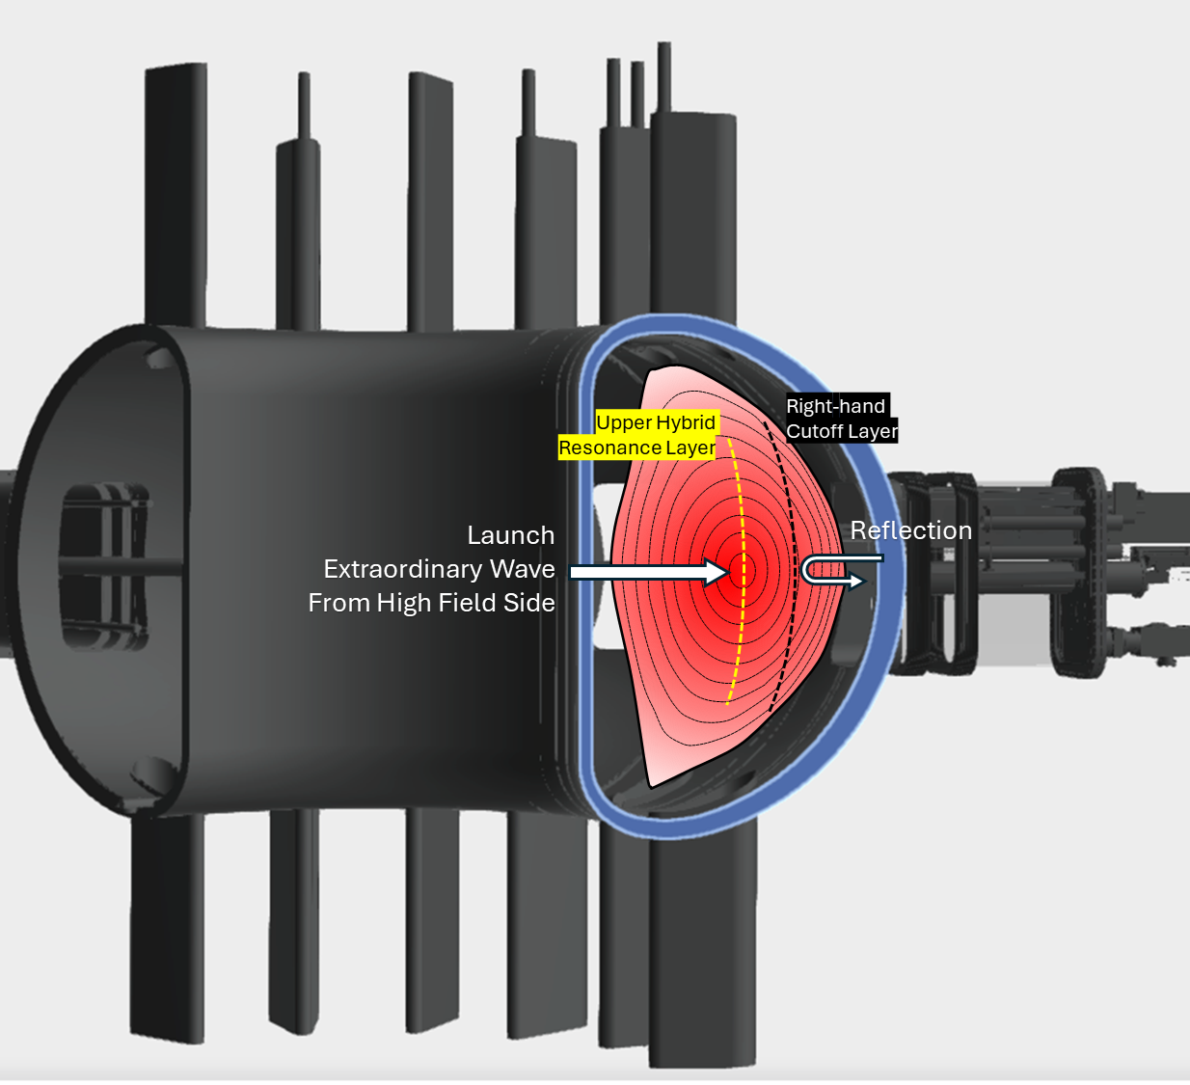
Section VI: Launching Extraordinary Waves in Tokamaks for Runaway Electron Suppression
The extraordinary wave near upper-hybrid resonance is predicated to effectively suppress runaway electron
1.Low field side will be reflected by right hand cutoff layer
2.High field side could effectively reach to the target layer
3.Resonance position rely on the wave frequency

Slide 12
Section VII: Summary
The Anomalous Doppler Effect has been identified as an effective mechanism for suppressing runaway electron energy by scattering the electron's parallel energy into perpendicular energy. Through studying the interaction between electrons and electromagnetic waves, this approach offers an innovative solution for runaway electron suppression in tokamaks, requiring a left-hand circularly polarized beam with an intensity of 9 W/m² based on the EAST startup scenario. In practical tokamak applications, the extraordinary wave predominantly contains left-hand circular polarization components and can be launched from the high-field side of the tokamak. Resonance at the upper hybrid layer drives the Anomalous Doppler Effect within the plasma core, effectively limiting the increase in runaway electron toroidal momentum. Numerical simulations demonstrate that when the electric field exceeds the critical threshold, the electromagnetic wave captures the parallel momentum of the electrons, continuously transferring energy from the parallel electrostatic field to rotational energy and resonant waves.

